Slide 1
Next Dish
Finding your next vegan meal
By Chris Davis
Notes:
A lot of projects focused on providing some interesting analysis that could be used to drive the bottom line, or some specific business strategy. For my project, I’m hoping to shift gears a little to see how we could use statistics to drive product development. I instead chose to look at how I could use statistics and machine learning in product development – or at least, in developing a feature. For that reason, the product idea that I’ll be presenting would require a longer investment by either an established company to see a fully fledged product in the hands of users, or potentially serve as a small, first iteration startup idea. I’ll assume that my stakeholders are folks who would be taking the initial work that I was able to do, and build an interface around it. Without further ado…

Slide 2
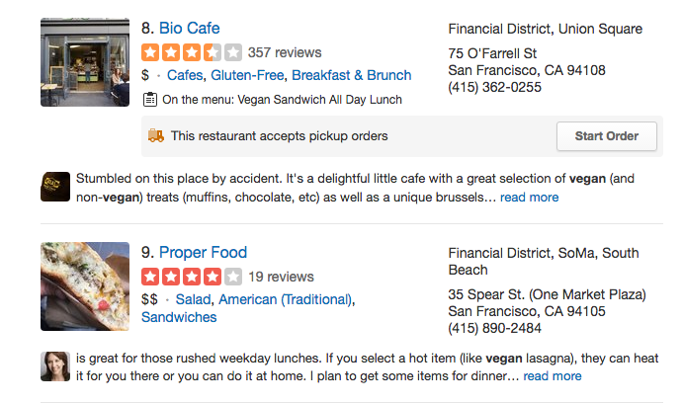
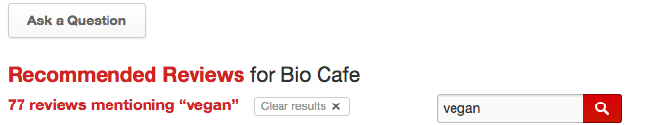
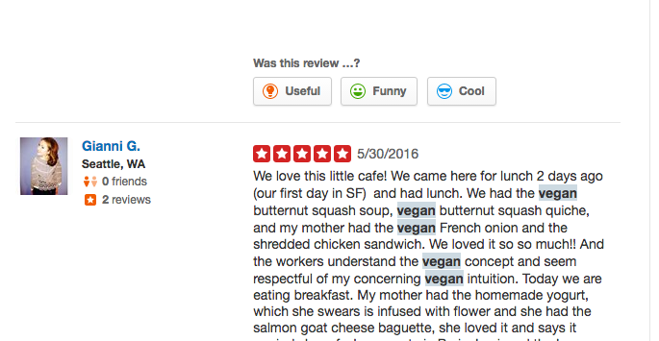
Next Dish
Notes:
As a vegan, it’s hard to find what I can eat on existing products. On web, the experience is tough, but it’s even worse on mobile, and when you’re in different areas of the city or different times, you’ll be lucky to surface anything that matches a ‘vegan’ query
-- In a way it makes sense because these products were developed many years ago, before data analysis had gone through significant maturation

Slide 3
Problem
Next Dish
Where can I eat vegan food?!
At BEST:
Surface vegan-only venues, but that’s only 2% of SF
More commonly, vegan searches = noise (tips, reviews)
→ A tool that tells you which dishes you can eat
Data
Problem
Widget
Model
Wrap
Notes:
Let’s cut to the chase, find me dishes I can eat. My hypothesis was we could leverage data to help us guess which dishes are vegan. If we can do that, we can go directly to them and surface those, instead of making users go through a meticulous repeated process every time they want to look for food.

Slide 4
Problem Solved (?)
Next Dish
Not entirely
Tough problem classifying anomalies (as I guessed, but still)
Achievements
Made tool for identifying food groups
Minimized technical bottlenecks
Data
Problem
Widget
Model
Wrap

Slide 5
Market Potential
Next Dish
Nascent market, but pain point is very large
30% millennials eat meat alternatives/week
*http://www.mintel.com/global-food-and-drink-trends; http://latestvegannews.com/plant-based-food-named-top-trend-2016/ (2015)
Dietary anomalies in the US diet
8 allergens | 90% allergens
Milk, egg, peanut, tree nut, fish, shellfish, soy, wheat/gluten
Data
Problem
Widget
Model
Wrap
Notes:
Small digression about why this is worth pursuing ======
often how products get big is by solving a big pain point for a few customers, and then address pain points of the next biggest segment of a market, until you become ubiquitous as a tool
It’s also a good sign that innovation is needed when people are settling for sub-par solutions::::: (FOR EXAMPLE)
There’s one app currently that filters out restaurants that are non-vegan, but it costs $5 to download, and if there’s nothing near you, it won’t surface anything….

Slide 6
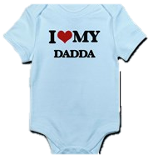
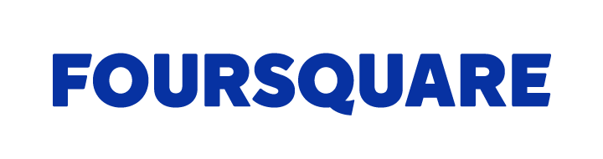
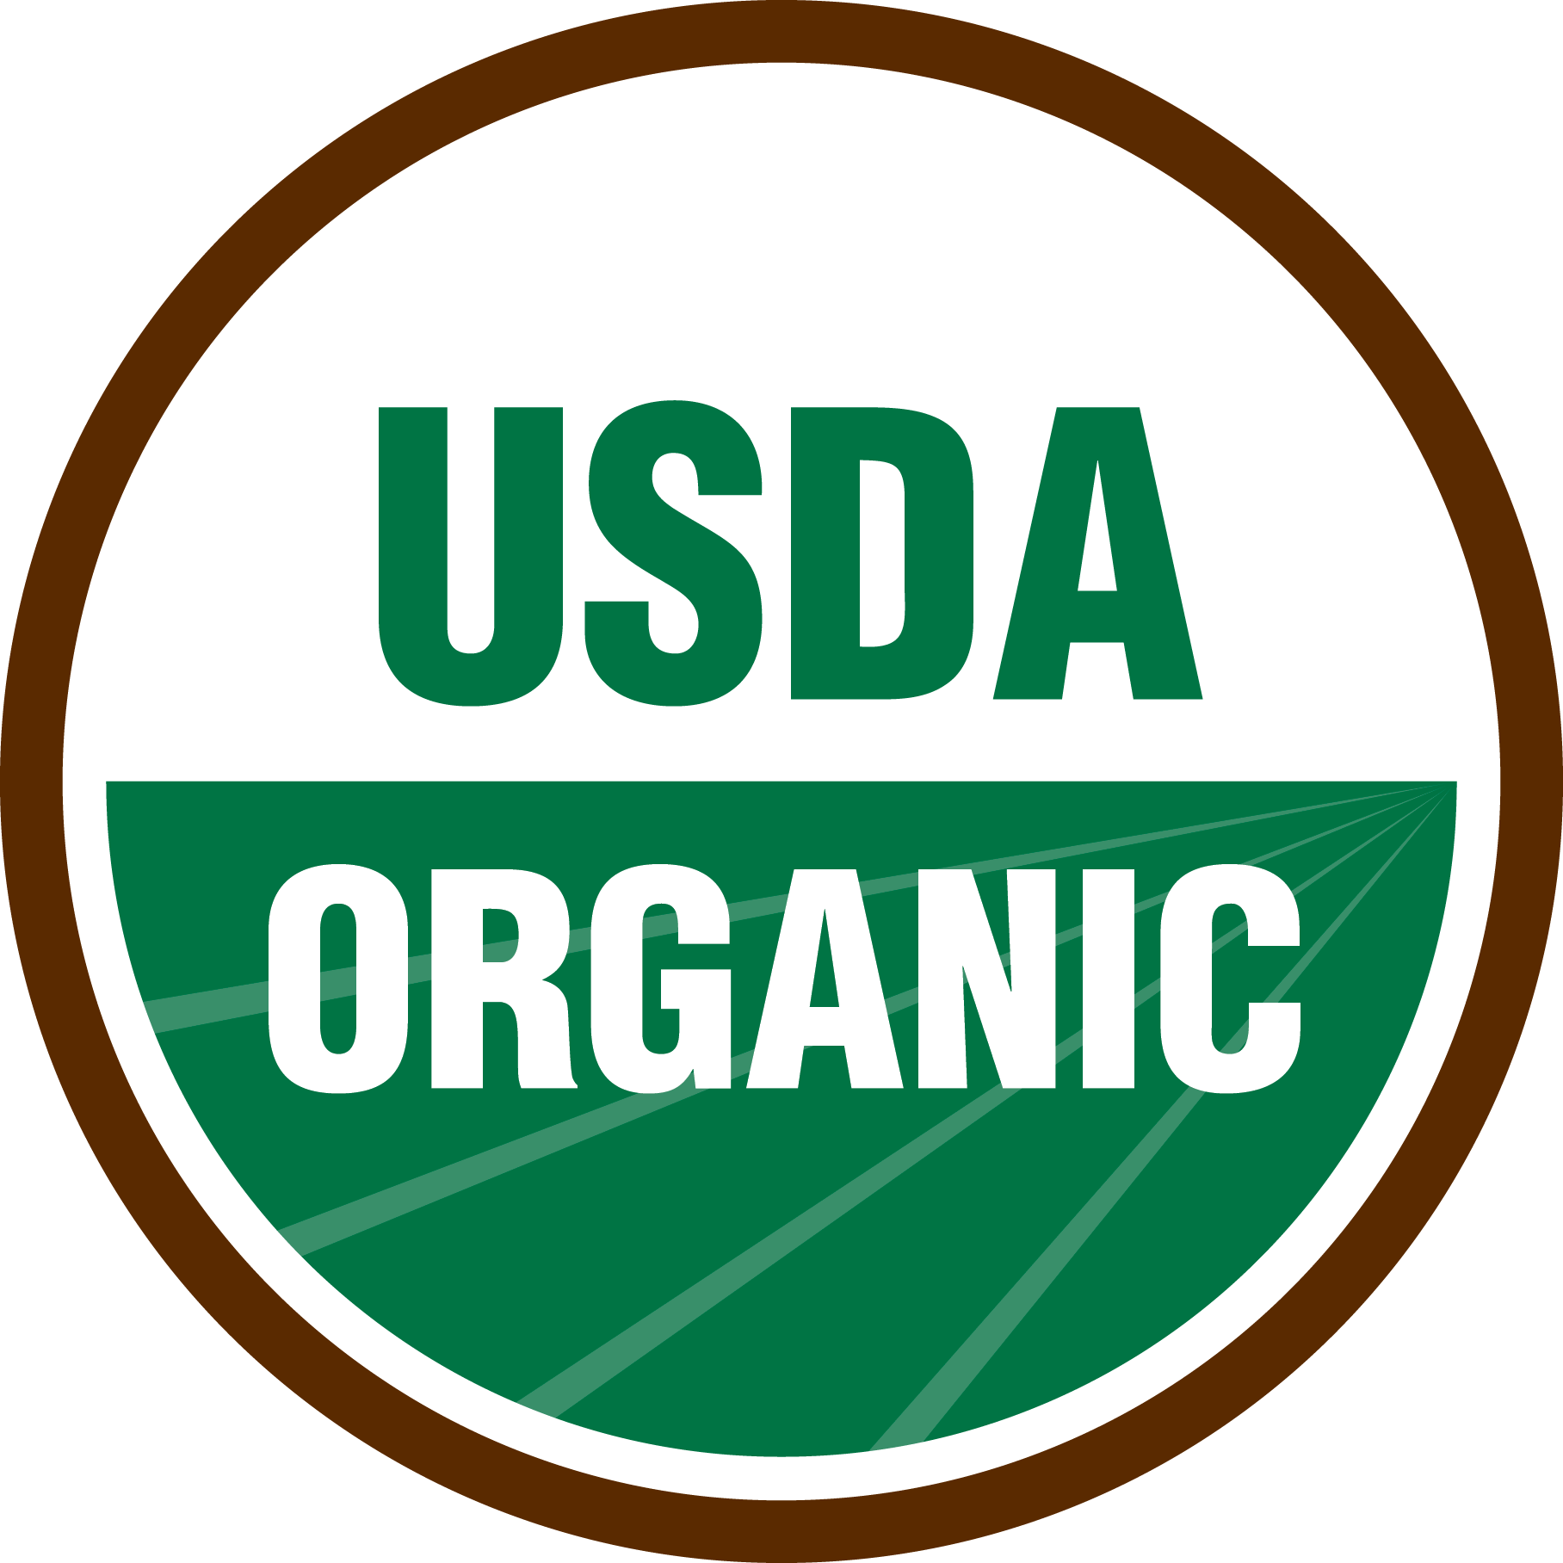



Data
Next Dish
Data
Problem
Widget
Model
Wrap
Notes:
Back to the project tho,
** Try to be no more than 5 mins in

Slide 7
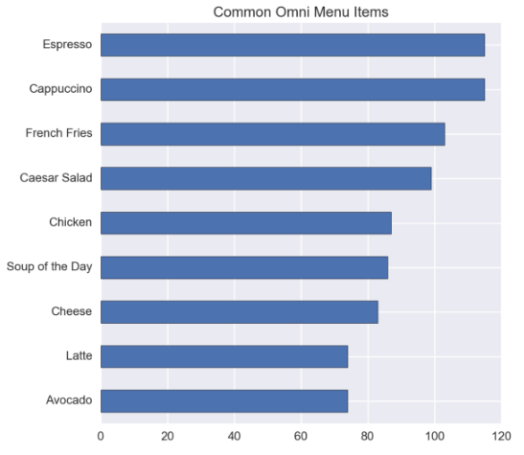
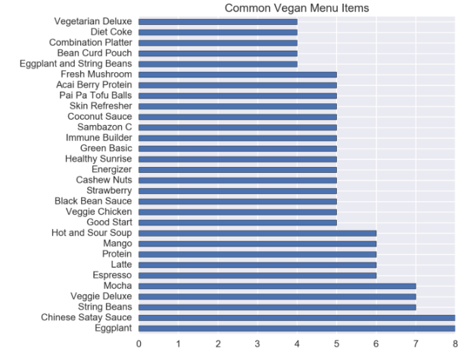
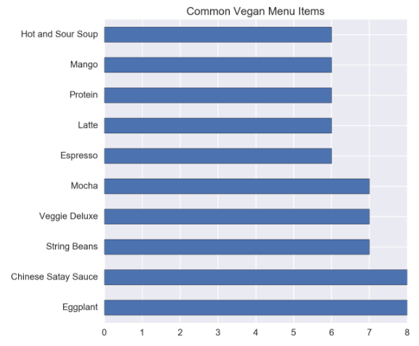
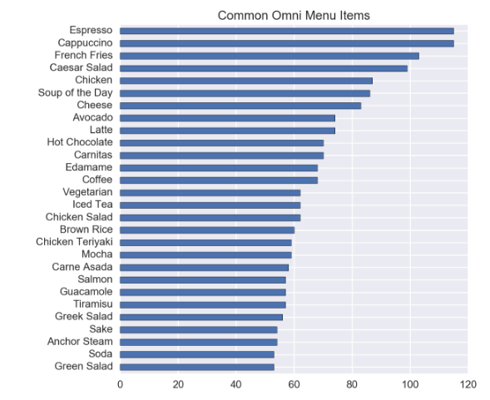
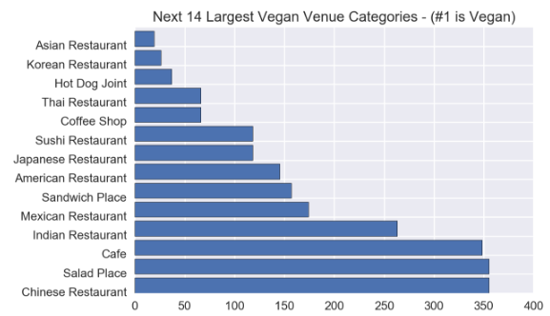
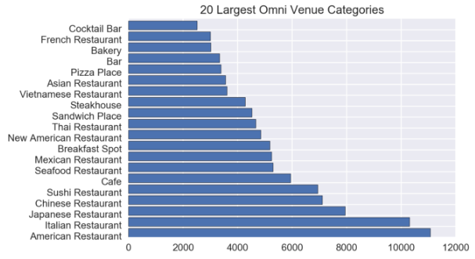
Order Up
Next Dish
Data
Problem
Widget
Model
Wrap
Notes:
Generally there is more variety in the vegan restaurant menu set, because we have a lower proportion of repeating items across venues
(also has to do with how many diverse ethnic options exist in the vegan menu set; as a proportion of the whole, they are much greater, as in HOW MUCH PERCENT, CHECK THE REPORT
- eight out of the next 14 categories have an ethnic affiliation, buttressing the notion that the names of vegan foods tend to be more diverse as well – omni foods have 9 ethnic groups in their top 20, a smaller proportion

Slide 8
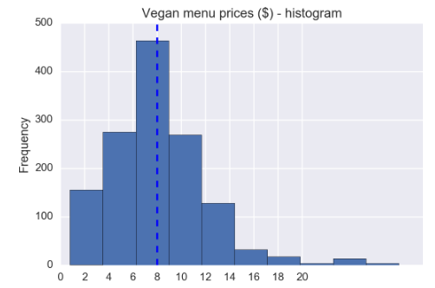
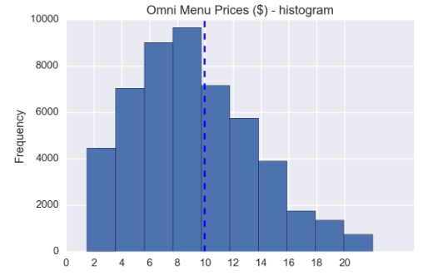
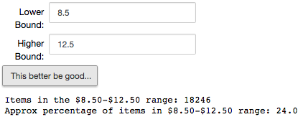
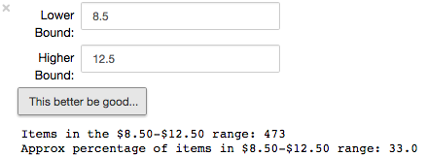
“More money, fewer problems”
Next Dish
Data
Problem
Widget
Model
Wrap
Notes:
The common wisdom is that vegan food is more expensive, particularly when you eat out.
But as this shows, it has much more to do with WHICH vegan restaurant you choose to eat at, much like there are omni restaurants that are more and less expensive
Also a more normal curve for vegan prices, showing that the max prices you’ll pay at any vegan restaurant are also capped relative to omni restaurants,
AND here’s my little plug, there is actually a greater portion of items available in that range than for the omni subset (almost 10%), but true, there are fewer items, and fewer outlier prices

Slide 9

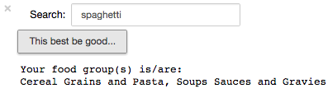
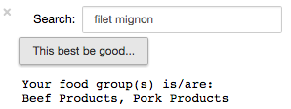
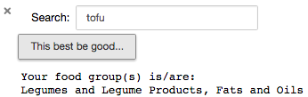
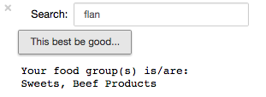


Boiled down
Next Dish
Data
Problem
Widget
Model
Wrap
Notes:
Now to get into how I approached preparing the data, so that the model(s) would be able to predict vegan/non-vegan
I made another tool, but this one takes as an input a food-related term, and then it gives you a prediction for what good groups it thinks that food belongs to.
SO the theory was: I could feed my menu descriptions through this tool, and they’ll apply food groups, just like I’ve demonstrated here. After that, I’d be able to create new features (variables) for each dish that would simply say whether or not that item belonged to one of 25 different food groups. Then, I’d compare the food group variables, with the vegan vs non-vegan variable, and make a prediction based off of that.
2) But let’s first work backwards to explain how I built that tool. If we go one step back, we can see that I have assigned scores to each of the food groups that possibly created a match,
And then I just ranked them in order.

Slide 10
Ingredients of a Prediction widget
Next Dish
1) USDA Food Groups
Twenty-Five (25) from a 8,194 unique items
Batch item descriptions into each FG
2) Input word (food term)
Compare term across 25 FG’s
Surface the best matches!
Data
Problem
Widget
Model
Wrap
Notes:
So where do the numbers come from, that allowed me to make those predictions?
Three –fold answer: A) I split up the 25 food groups into their respective descriptions. This data was available from the USDA. Then, I run the query word/input/food-term through every food group, and look at how often the term appears among the decscriptions for that one group. I repeat this process for every group, keeping track of how often the term matches descriptions across every group. Finally, I surface the groups that have the matched the best with the food term.
This is similar to what a multi label classifier would do, and a vectorizer, except I optimized one using the USDA data, so that’d it’d be able to give me specific food groups.
In the end, I like the idea of sorting food into food groups, because then the product generalizes more easily to folks w/ other restrictions, like lactose intolerance, nut allergies, etc.

Slide 11
Next Dish
Take scraped Foursquare menus
Organized by menu item
Scale up data w/ widget
Vegan?
Organize USDA data
Modeling
Joined 25 FG’s and 8,194 items into one dataset
Foursquare + USDA + widget = processed data
Or Not?
Classify binary data and make predictions
Data
Problem
Widget
Model
Wrap
Notes:
Now that I hard all the individual components, I was ready to put everything together, and see what we could predict.
First, I basically scaled up my efforts with the widget. So I fed all the Foursquare menus through my widget, and let it assign food groups. From there, I let the model tell me how well the food groups were helping to predict vegan vs non-vegan
{{ Title Placeholder: Processing/Modeling }}

Slide 12
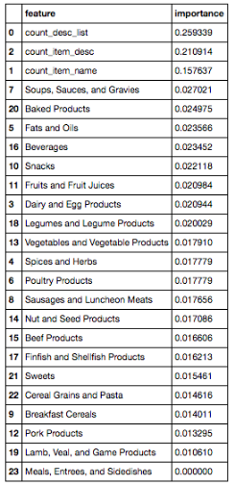
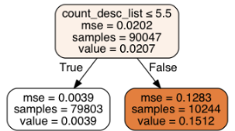
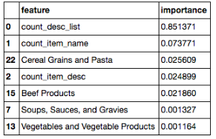
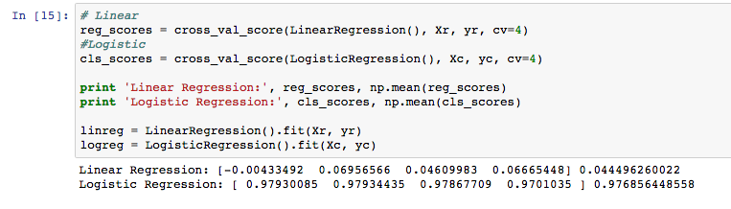
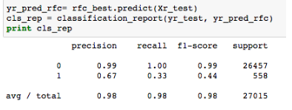
A model is like a recipe
Next Dish
Data
Problem
Widget
Model
Wrap
Notes:
In that it only performs as well as you prepared

Slide 13


ROC
Next Dish
What do you call a boomerang that doesn’t work?
… A stick
Notes:
joke

Slide 14
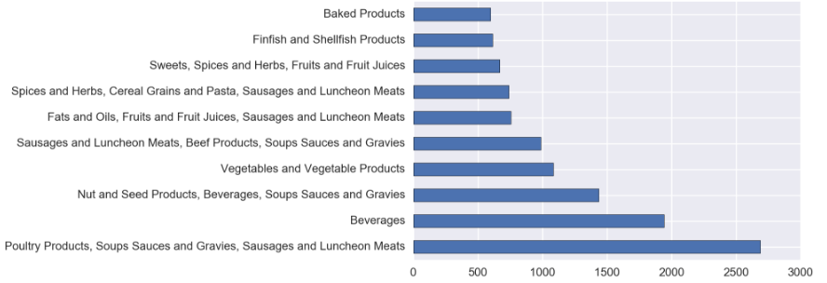
Mixed outcome
Next Dish
1) USDA Food Groups
Twenty-Five (25) from a 8,194 unique items
Batch item descriptions into each FG
2) Inpuce the best matches!
Data
Problem
Widget
Model
Wrap
Notes:
But in all seriousness…. You can tell that there are some things that are better differentiated, while others are less so.
** Sorry I can’t blow this up anymore, but I’ll read off what matters**
Better differentiated: Poultry, Beverages, Beef Products, Cereal Grains and Pasta (gluten), Fish and Baked Products
Worse performing groups: Soups Sauces and Gravies, Sausages and Luncheon Meats, Vegetable Products (b/c so many trace ingredients!!)

Slide 15

Bottlenecks and Regrets
Next Dish
Prune Foursquare menu data
Food Group Distinctiveness
Single-word → Multi-word matching
Data
Problem
Widget
Model
Wrap
Notes:
Complex menu items and descriptions from foursquare made it hard for my basic widget to process many of the items accurately
I can do this using custom n-grams, like if words have ‘tofu’ and ‘sausage’ one after the other – this usually indicates that there is no pork in the item (like ‘soy/almond/coconut’ and ‘milk’)
Get better food group separation, so that when items are grouped, the relationships are less co-dependent, and so that I can strengthen the dairy, egg, and meat type food groups for predicting vegan; actually, katerina used this cool classifier called One vs Rest, which deals with multi-label classification. I basically recreated that for my project, but that classifier is already functionally optimized to make each food group as distinct from the others as possible!
Also, single-word vs multi-word matching, so that when I pass through longer terms, my script will actually be able to surface matches that are strong matches. As of now, I have been splitting up queries of longer words into single word queries, which are just looped through several times. This also contributes to why it’s harder to deal with complex menu items from Foursquare

Slide 16

Product development
Next Dish
Address immediate bottlenecks in methodology
Source more menu data
*anomalous classifier dilemma
Gluten-Free, allergens, etc.
Data
Problem
Widget
Model
Wrap

Slide 17
Thanks for listening ☺
Next Dish
I’d love to hear your feedback.
If you’re interested in any aspect of my work, or would like to collaborate, you can reach me at chris@thoughtless.io

